Slide 1
Tutorial On Data and Model Lifecycle Management for Incremental Machine Learning Algorithms IEEE BigData 2023, Sorrento, Italy Dr. Seshu Tirupathi and Dhaval Salwala IBM Research Europe Dublin, Ireland

Slide 2
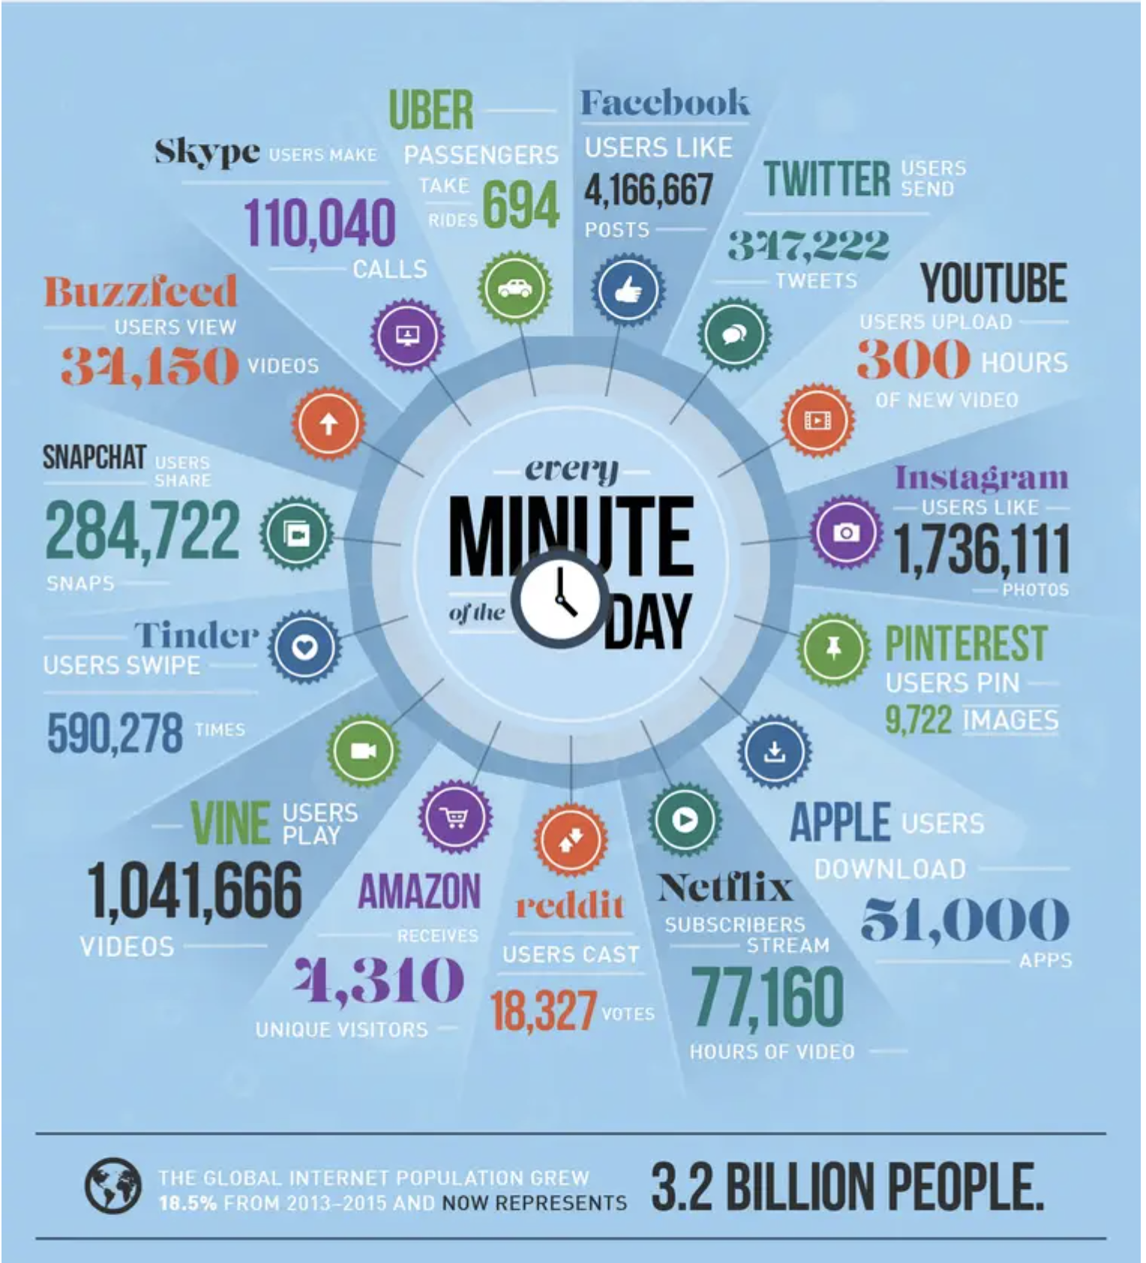
Motivation
Data is ever increasing with lowering costs of sensors, and communication.
Enterprise business requirements for high frequency data, ex. yaw misalignment in wind turbines.
Consistent and more dependable usage or resources.
https://www.oreilly.com/radar/the-world-beyond-batch-streaming-101/
https://wersm.com/how-much-data-is-generated-every-minute-on-social-media/

Slide 3
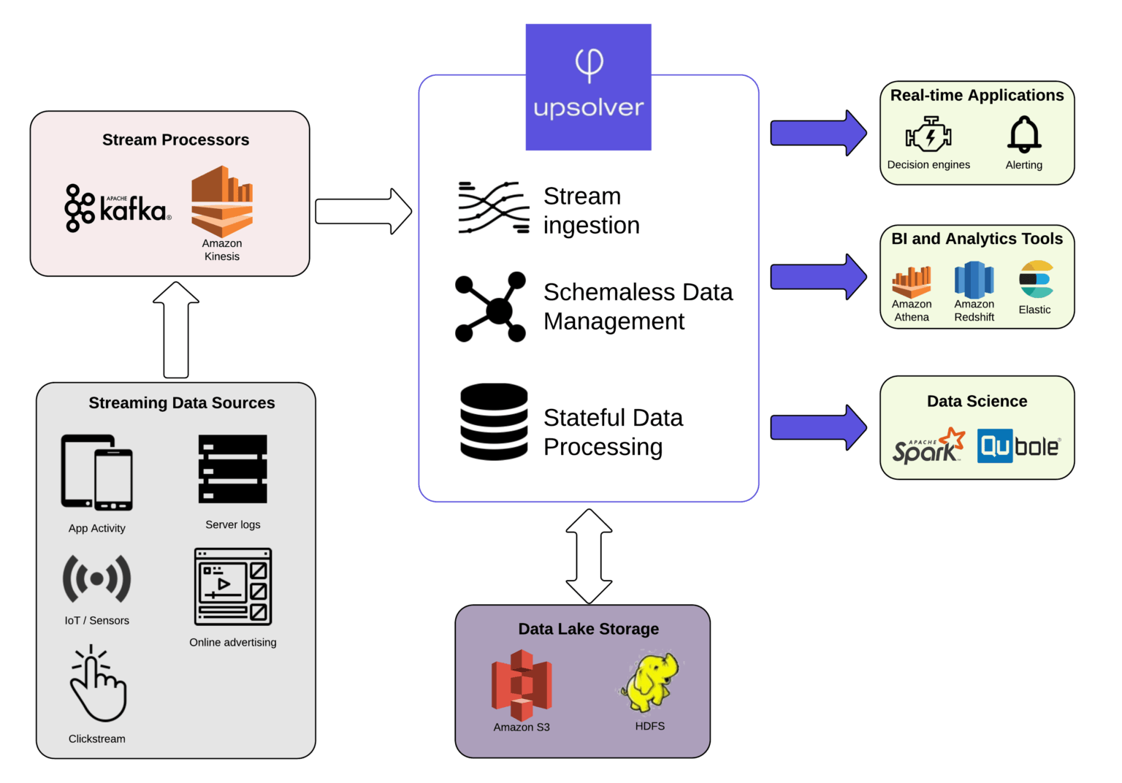
Use-cases
• Sensor data and internet of things: Sub-second data in wind turbines, traffic etc.
• Telecommunication: cell-phone data.
• Social media: sentiment analysis, topic discovery
• Epidemics and disasters
• Electricity demand prediction, short term forecasting etc.
https://hazelcast.com/glossary/streaming-database/

Slide 4
Incremental learning: Simple demonstration
Consider the benchmark Agrawal dataset for concept drift in structured data.
Simulates loan approval classification problem.
AutoML algorithm considers two models: batch Random Forest Classifier (RFC) and incremental Adaptive Random Forest Classifier (ARFC)
Abrupt drift in the data around 1500
AutoML algorithm detects the best algorithm based on prequential testing (best model at the last sample with observed ground truth)
0
01

Slide 5
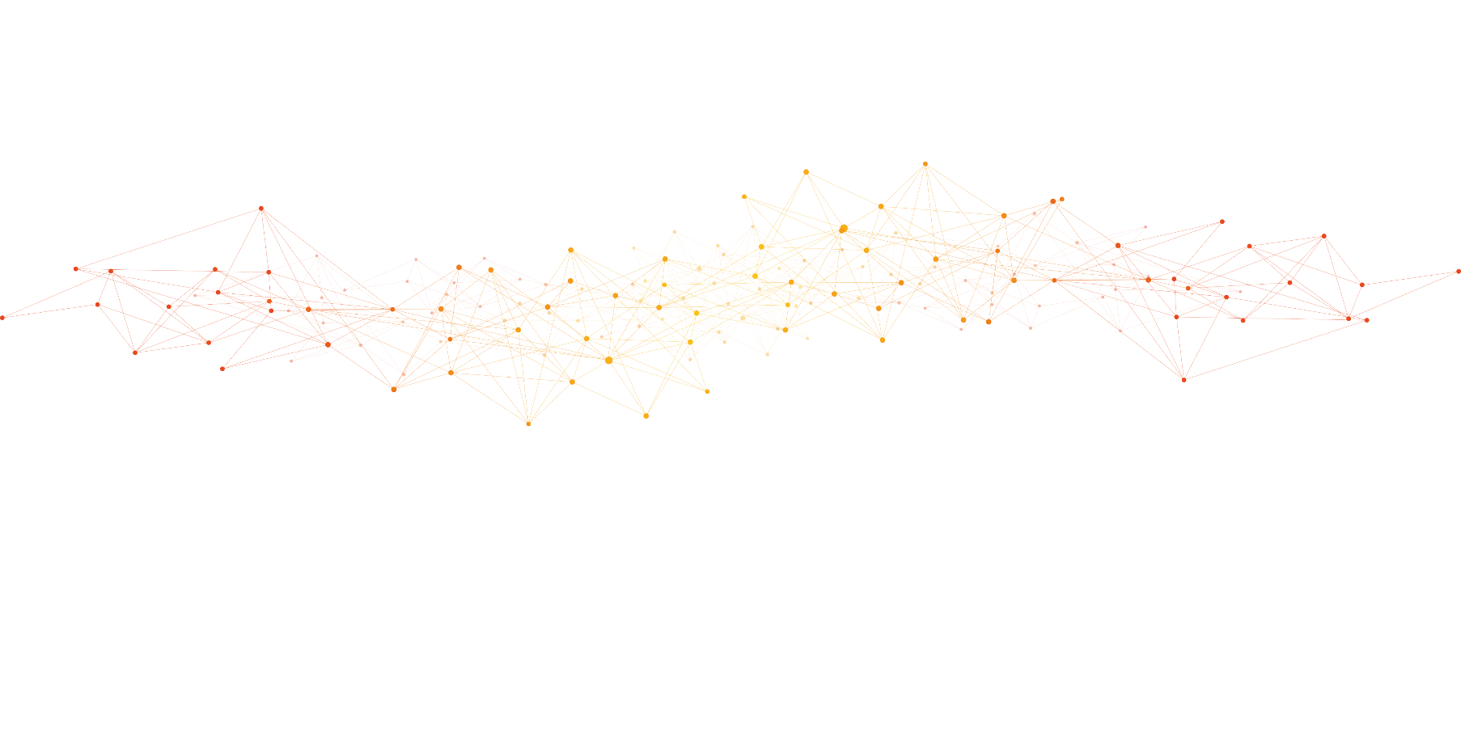
Incremental machine learning algorithms
Multiple variants of incremental machine learning algorithms:
Incremental learning: Model at time step t, M_{t}, incrementally learns using new data, S_{t} and M_{t-1}
Online learning: Model updated one sample at a time
Continual/lifelong learning: (Neural network) Model incrementally learns without forgetting old tasks
Mini-batch incremental learning: Models that are updated in mini-batches
01
S₀
S₁
S₂
S₃
S_{t-1}
S_{t}
--------------------
M₀
M₁
M₂
M₃
M_{t-1}
M_{t}
--------------------
time

Slide 6
Learning from data streams
Time constraints for data retrieval and analysis.
Memory constraints for storage and computation.
ML model with a single scan of the incoming data.
Ability to deal with concept drift.
Exact constraints are use-case and infrastructure dependent.
Gama, Joao et. al. "Issues in evaluation of stream learning algorithms." Proceedings of the 15th ACM SIGKDD international conference on Knowledge discovery and data mining. 2009.
https://www.upsolver.com/blog/streaming-data-architecture-key-components

Slide 7
01

Slide 8
01

Slide 9
What about analytics?
01

Slide 10
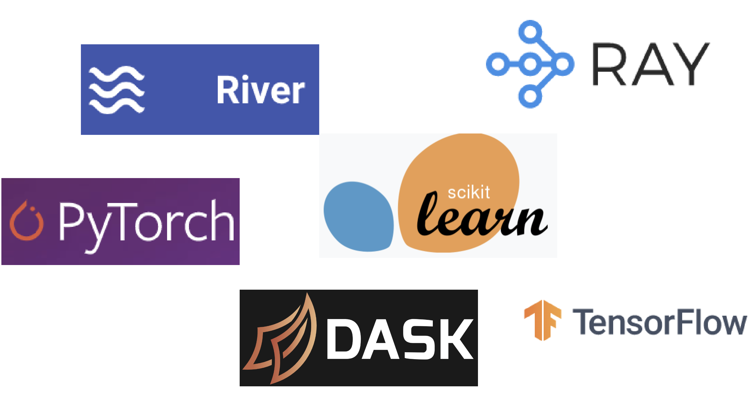
What about analytics?
01

Slide 11
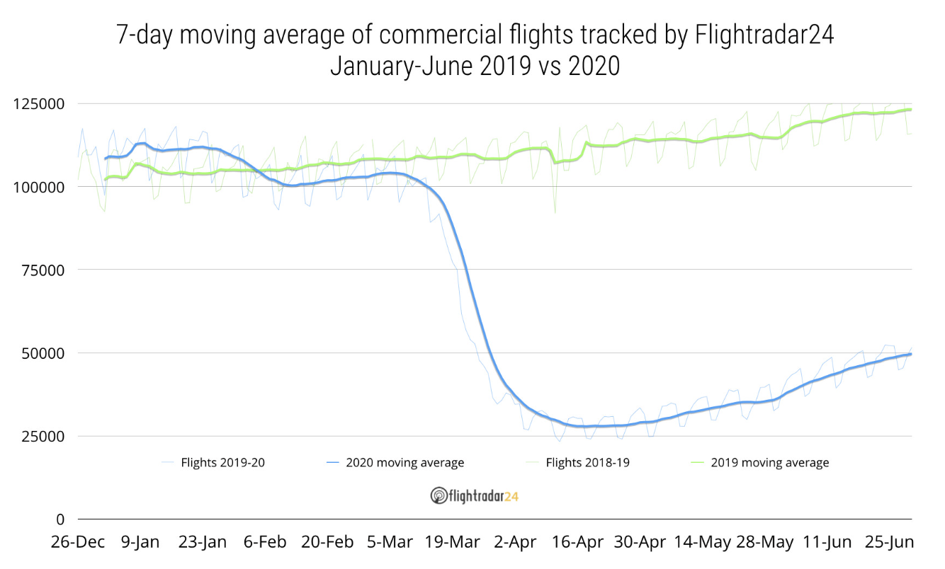
Drift example
https://www.flightradar24.com/blog/flight-activity-rises-in-june-still-far-below-2019-levels/

Slide 12
Concept drift
Data stream can be considered a process of joint distribution over random variables Y and X = {X₁, ..., X_{n}}
Concept = P(X,Y)
Concept drift occurs when P_{t}(X,Y) P_{u}(X,Y)
P_{[t,u]}(X,Y) P_{[v,w]}(X,Y)
• Real drift: Change in P(Y|X) with or without changes in P(X)
• Virtual concept drift: Change in P(X) or P(Y) that does not effect decision boundaries.
Oliveira, Gustavo et. al. "Tackling Virtual and Real Concept Drifts: An Adaptive Gaussian Mixture Model Approach." IEEE Transactions on Knowledge and Data Engineering (2021).
Webb, Geoffrey I., et al. "Understanding concept drift." arXiv preprint arXiv:1704.00362 (2017).

Slide 13
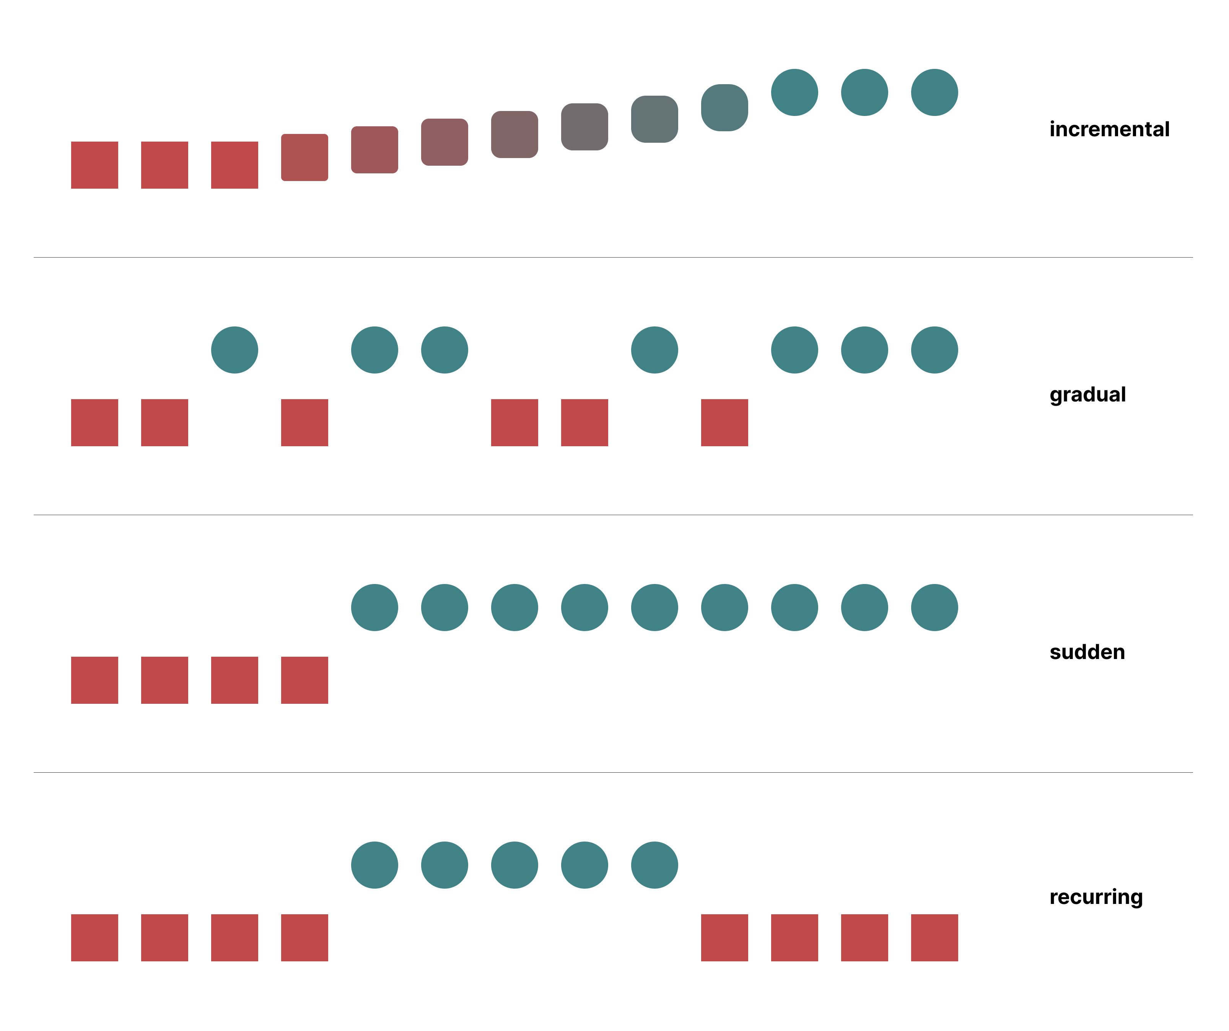
Drift types

Slide 14
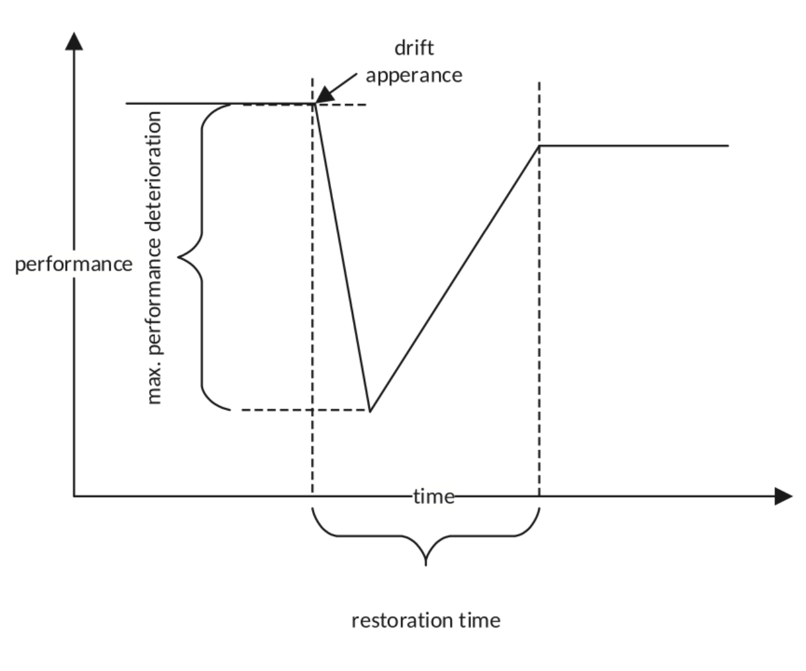
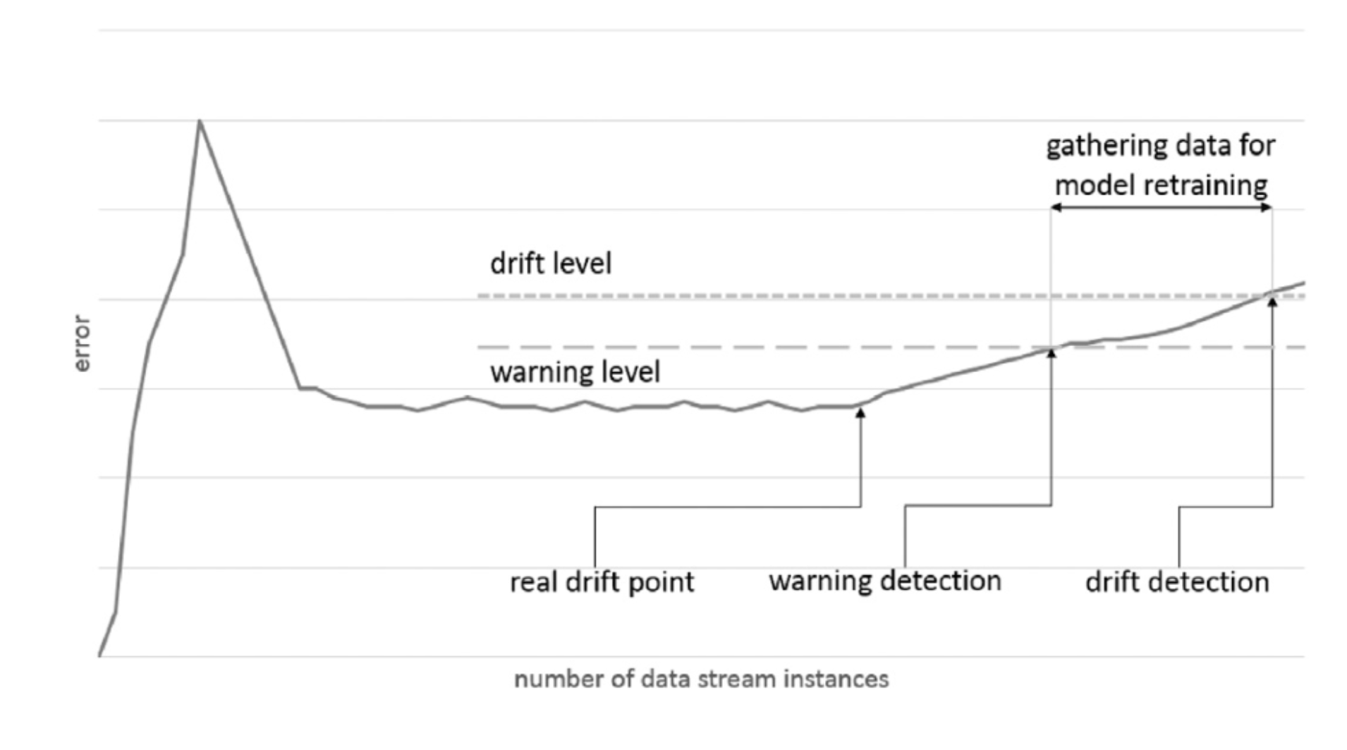
Drift detection
Krawczyk, Bartosz, et al. "Ensemble learning for data stream analysis: A survey." Information Fusion 37 (2017): 132-156.

Slide 15
Ensembling and AutoML
AutoML and ensembling of incremental models:
For batch learning models, the process is offline and controlled through a validation dataset.
For incremental models, AutoML (and ensembling) needs to be dynamic where best algorithms can depend on the concept.
AutoML is highly vulnerable to data inconsistencies during offline data analysis, which will cause unfavourable effects and incorrect model selection.
Quickly adapting to different frequency of data, detecting distribution changes and adapting to different model ensembling is still a challenge in traditional AutoML systems.

Slide 16
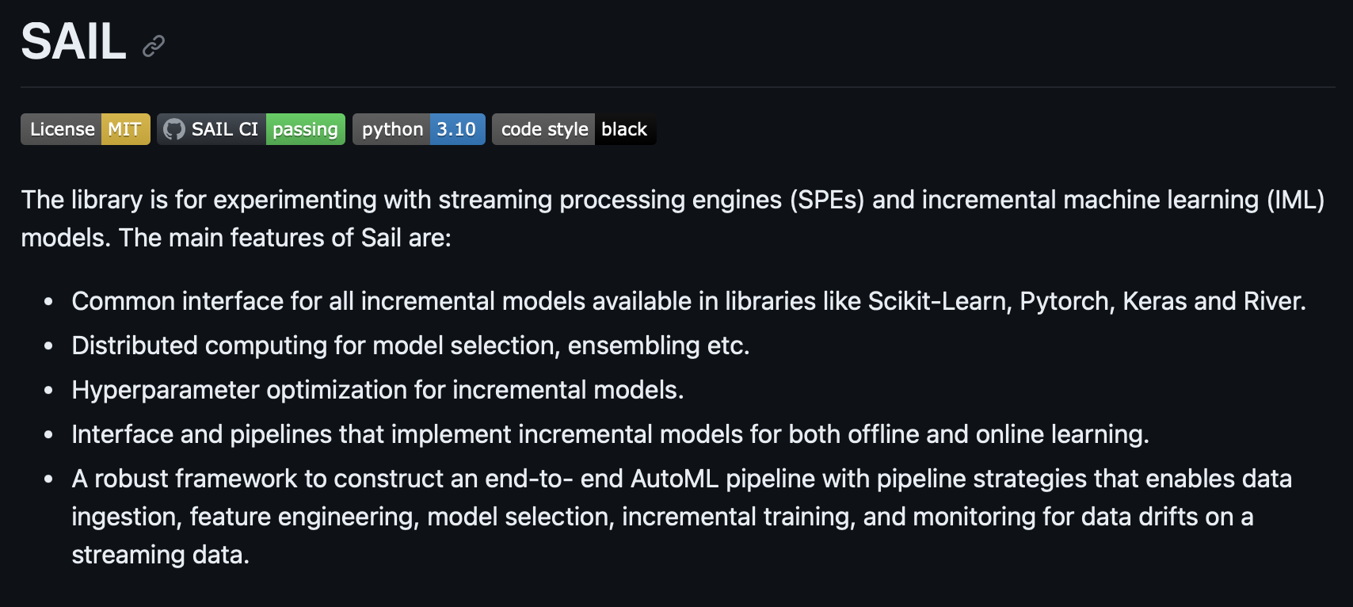
Introduction to SAIL
GitHub: https://github.com/IBM/sail
Wiki: https://github.com/IBM/sail/wiki

Slide 17
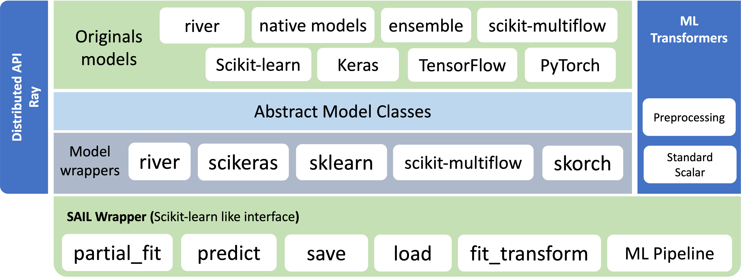
SAIL Architecture

Slide 18
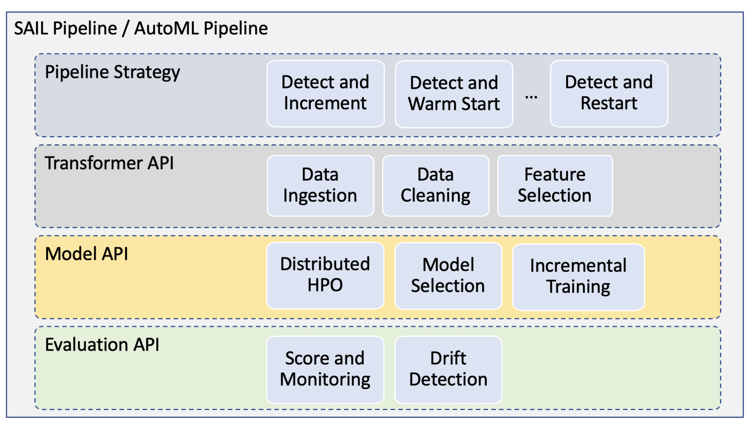
SAIL Incremental Pipeline

Slide 19
Why this tutorial ?
This Tutorial will help you understand step-by-step instructions on incremental model development and learn to use open-source knowledge to build a strong foundation in their early research career.
Participants will learn about AutoML of incremental machine learning algorithms using the SAIL library. They will learn the concepts of iterative development by fine- tuning models based on learning from continuous data streams.
SAIL abstracts away much of the complexity of machine learning, allowing researchers to focus on their research questions rather than spending excessive time learning intricate details of model building and monitoring.
SAIL helps researchers efficiently and quickly wraps model from machine learning libraries like Keras, PyTorch, Scikit-Learn and River.
It provides a user-friendly scikit-learn like interface for trying out various pre-processing techniques, feature engineering strategies, distributed model selection and evaluation. This saves efforts when experimenting with different model APIs and architectures.

Slide 20
Python 3.10
Install SAIL from GitHub https://github.com/IBM/sail
Install SAIL from Pypi repository https://github.com/IBM/sail/wiki/Installation#1-installing-from-public-pypi-repository
SAIL Wiki https://github.com/IBM/sail/wiki
Installation

Slide 21
Use any streaming dataset (at least 1M data [points)
From River 1. https://riverml.xyz/0.19.0/recipes/reading-data/ 2. https://riverml.xyz/0.19.0/api/datasets/AirlinePassengers/
Step 1
Choose an Open-source streaming dataset

Slide 22
Step 2 [Classification or Regression Task]
Write an incremental machine learning algorithm using machine learning libraries - Keras, PyTorch or pure Python-based
Note: We encourage participants to implement any well-known research work on incremental learning. It is not required to implement the entire research paper. A part but valid implementation of the research work is expected.
Examples
For Torch based model:
Source: src/sail/models/torch/rnn.py
Notebook: examples/pipeline/sail_pipeline_regression_torch.ipynb
For Keras based model:
Extending tf.keras.Model
Source: src/sail/models/keras/oselm.py
Notebook: examples/pipeline/sail_pipeline_regression_keras.ipynb
Sequential Model
Source: src/sail/models/keras/sequential.py
Notebook: examples/pipeline/sail_pipeline_classification_keras.ipynb
For native Python models:
Source: src/sail/models/native/isvm.py

Slide 23
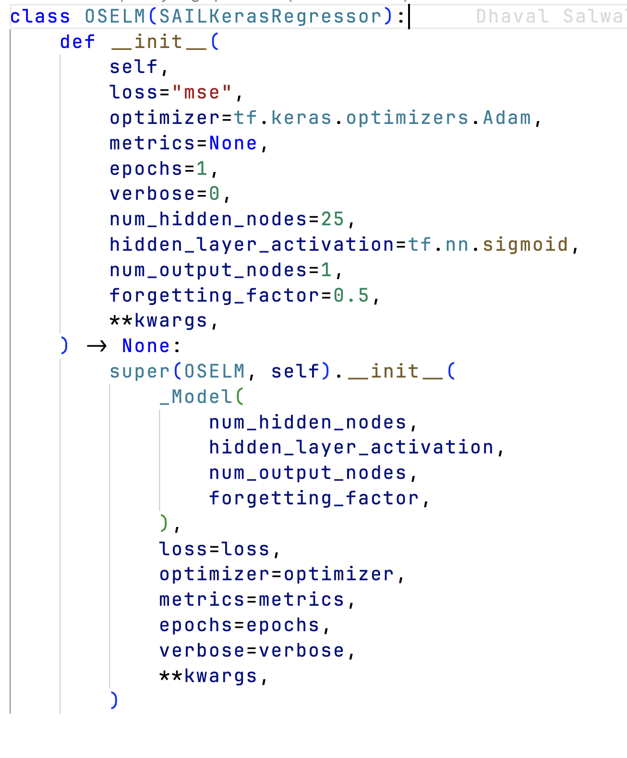
Step 3
Wrap incremental model inside a SAIL Wrapper.
Keras Example
src/sail/models/keras/oselm.py
src/sail/models/keras/sequential.py

Slide 24
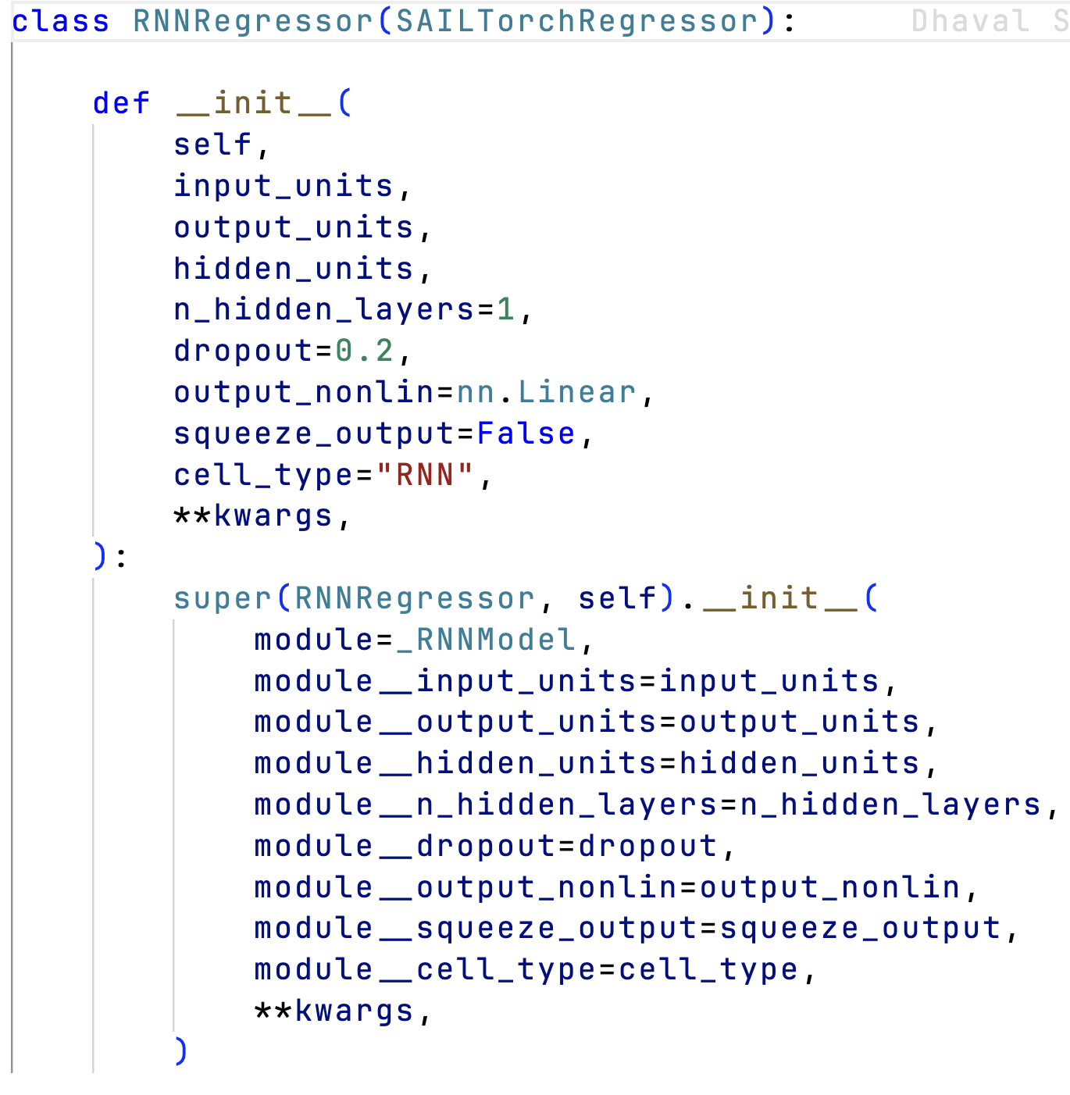
Step 3
Wrap incremental model inside a SAIL Wrapper.
PyTorch Example
src/sail/models/torch/rnn.py

Slide 25
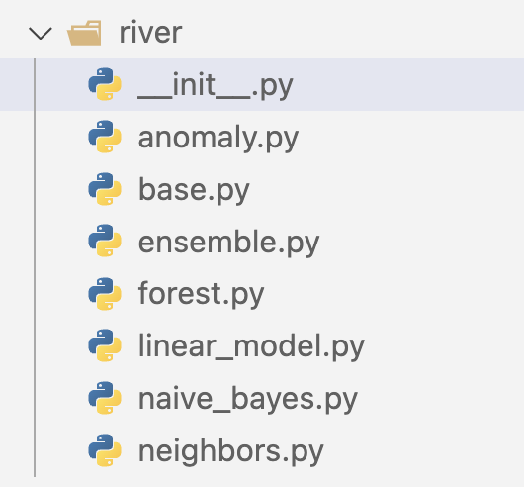
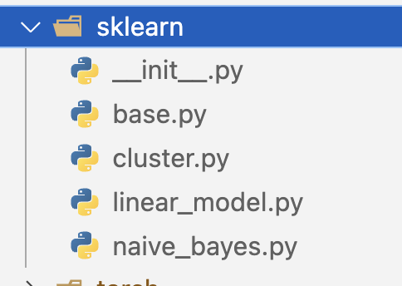
Step 4
Select any two incremental models (one from River and one from scikit-learn) from SAIL. These models are already wrapped inside a SAIL Wrapper.
River: src/sail/models/river
Sklearn: src/sail/models/sklearn

Slide 26
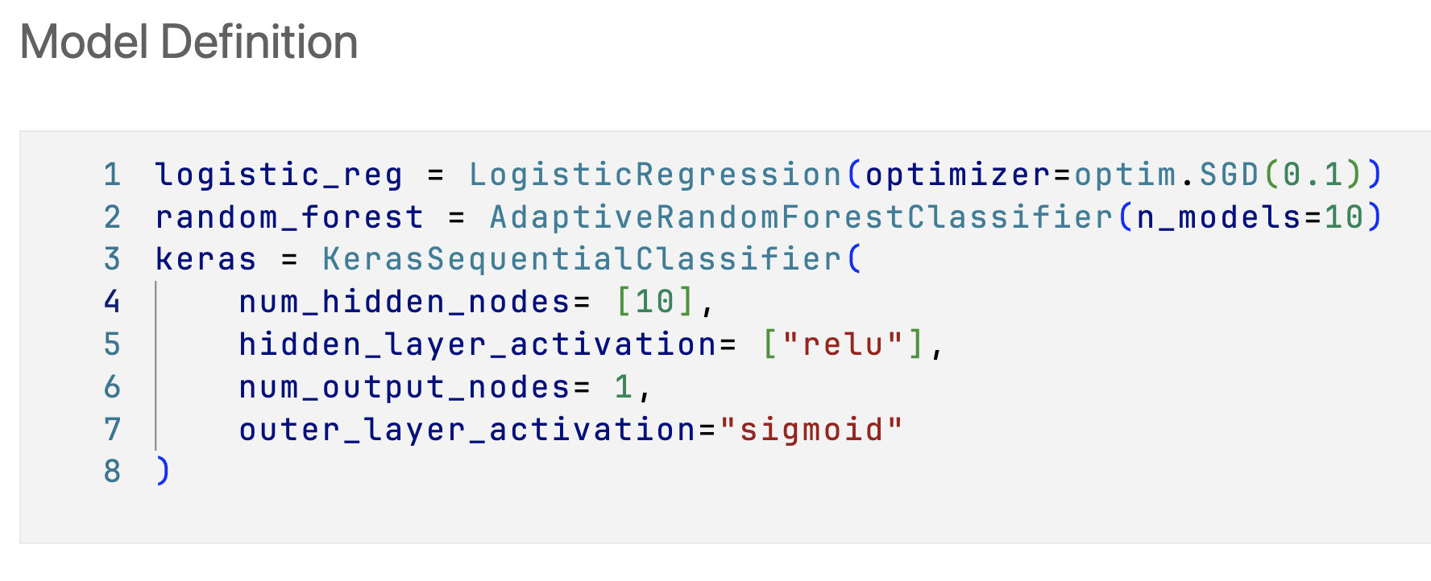
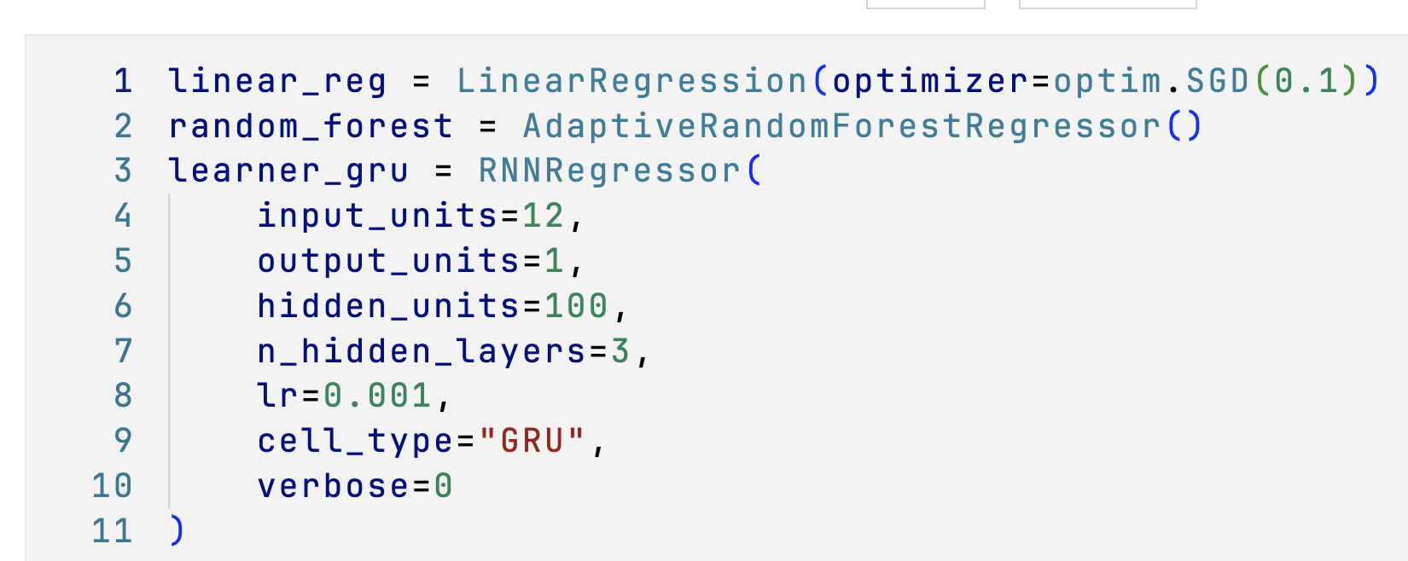
Step 5
Define you incremental models.
Keras: examples/models/auto_ml/sail_auto_pipeline_classification.ipynb
Torch: examples/models/auto_ml/sail_auto_pipeline_regression.ipynb

Slide 27
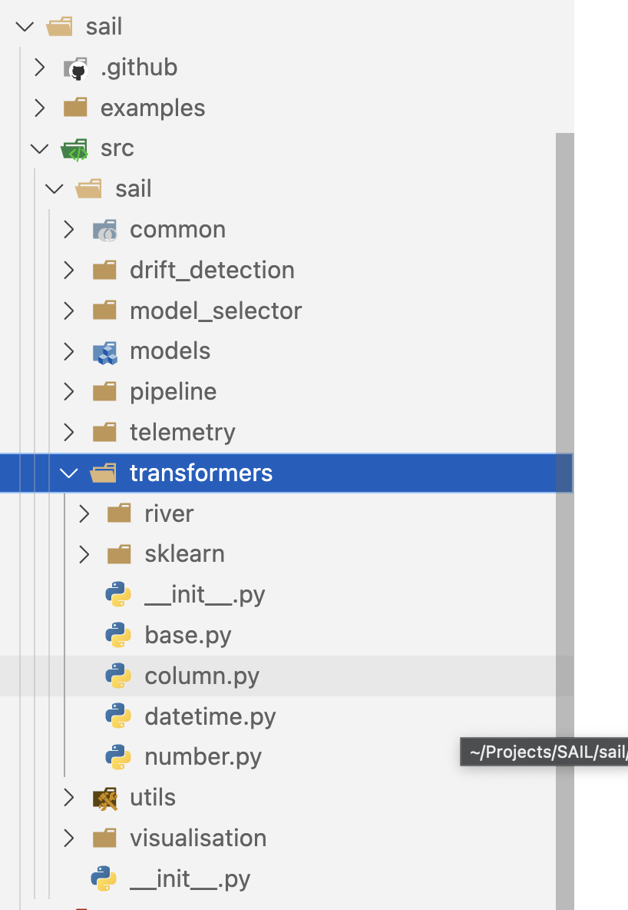
Step 6
Create SAIL Pipeline instance. If you want, you can add pre-processing transformers to the SAIL Pipeline.
Example
examples/models/auto_ml/sail_auto_pipeline_classification.ipynb
examples/models/auto_ml/sail_auto_pipeline_regression.ipynb

Slide 28
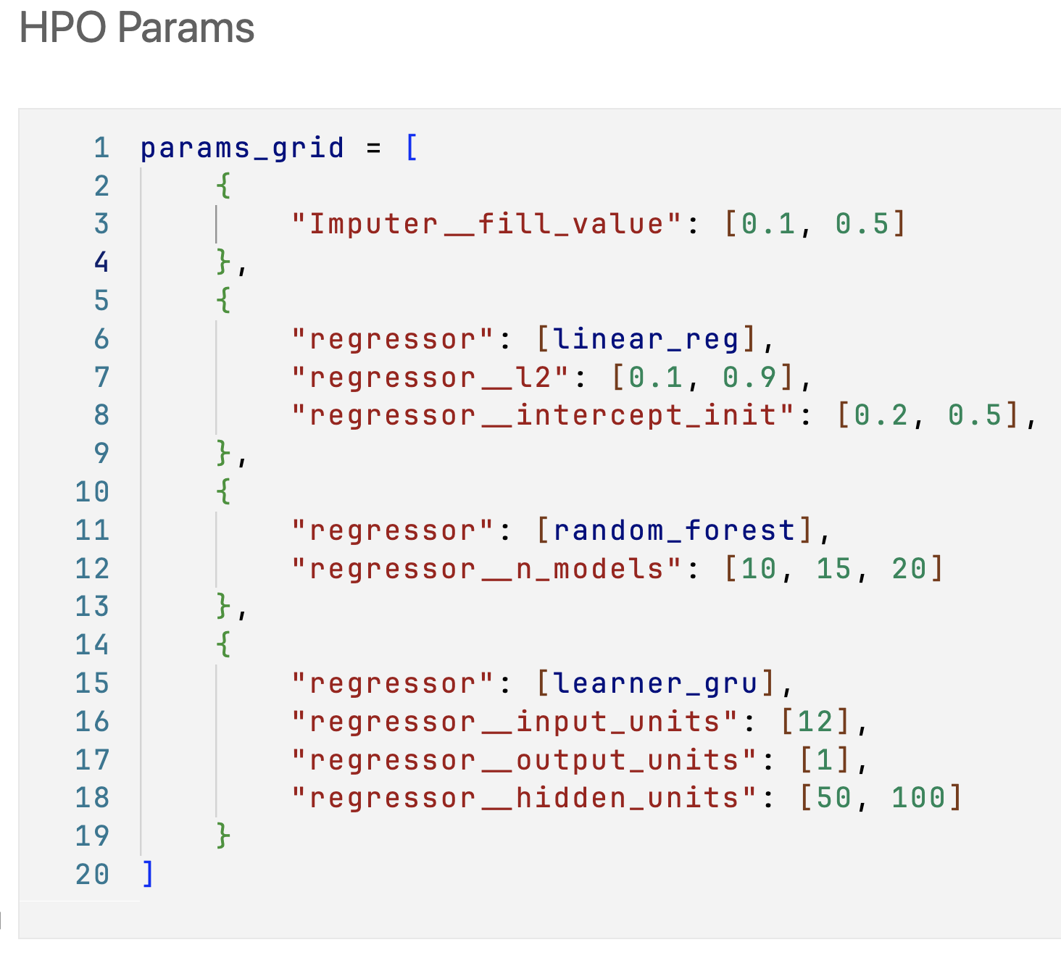
Step 7
Create grid-search parameter space for the chosen incremental models.
Keras: examples/models/auto_ml/sail_auto_pipeline_classification.ipynb
Torch: examples/models/auto_ml/sail_auto_pipeline_regression.ipynb

Slide 29
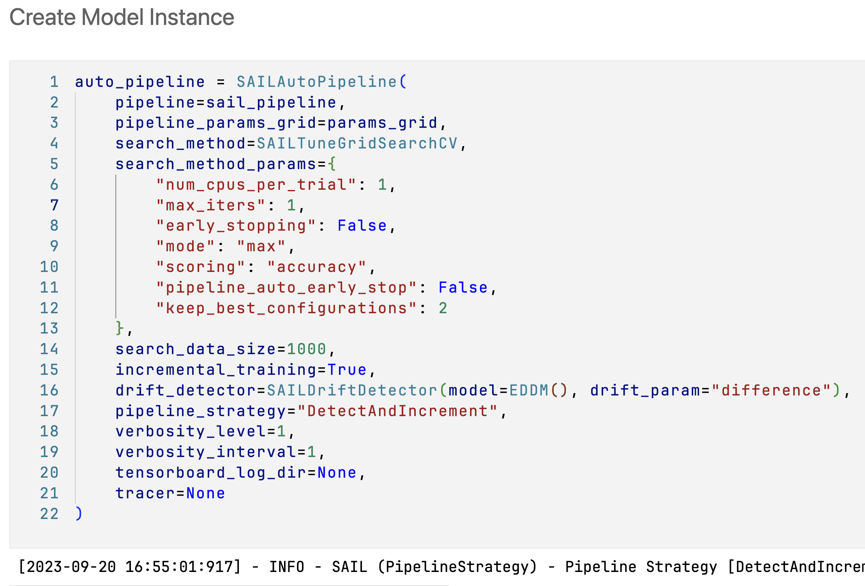
Step 8
Create SAIL Auto Pipeline. Choose search algorithm for model tuning like Random Search, Bayesian search etc.
SAILTuneGridSearchCV
SAILTuneSearchCV
Example
examples/models/auto_ml/sail_auto_pipeline_classification.ipynb
examples/models/auto_ml/sail_auto_pipeline_regression.ipynb

Slide 30
Step 9
Choose the best AutoML Strategy for the training.
Example examples/models/auto_ml/sail_auto_pipeline_classification.ipynb

Slide 31
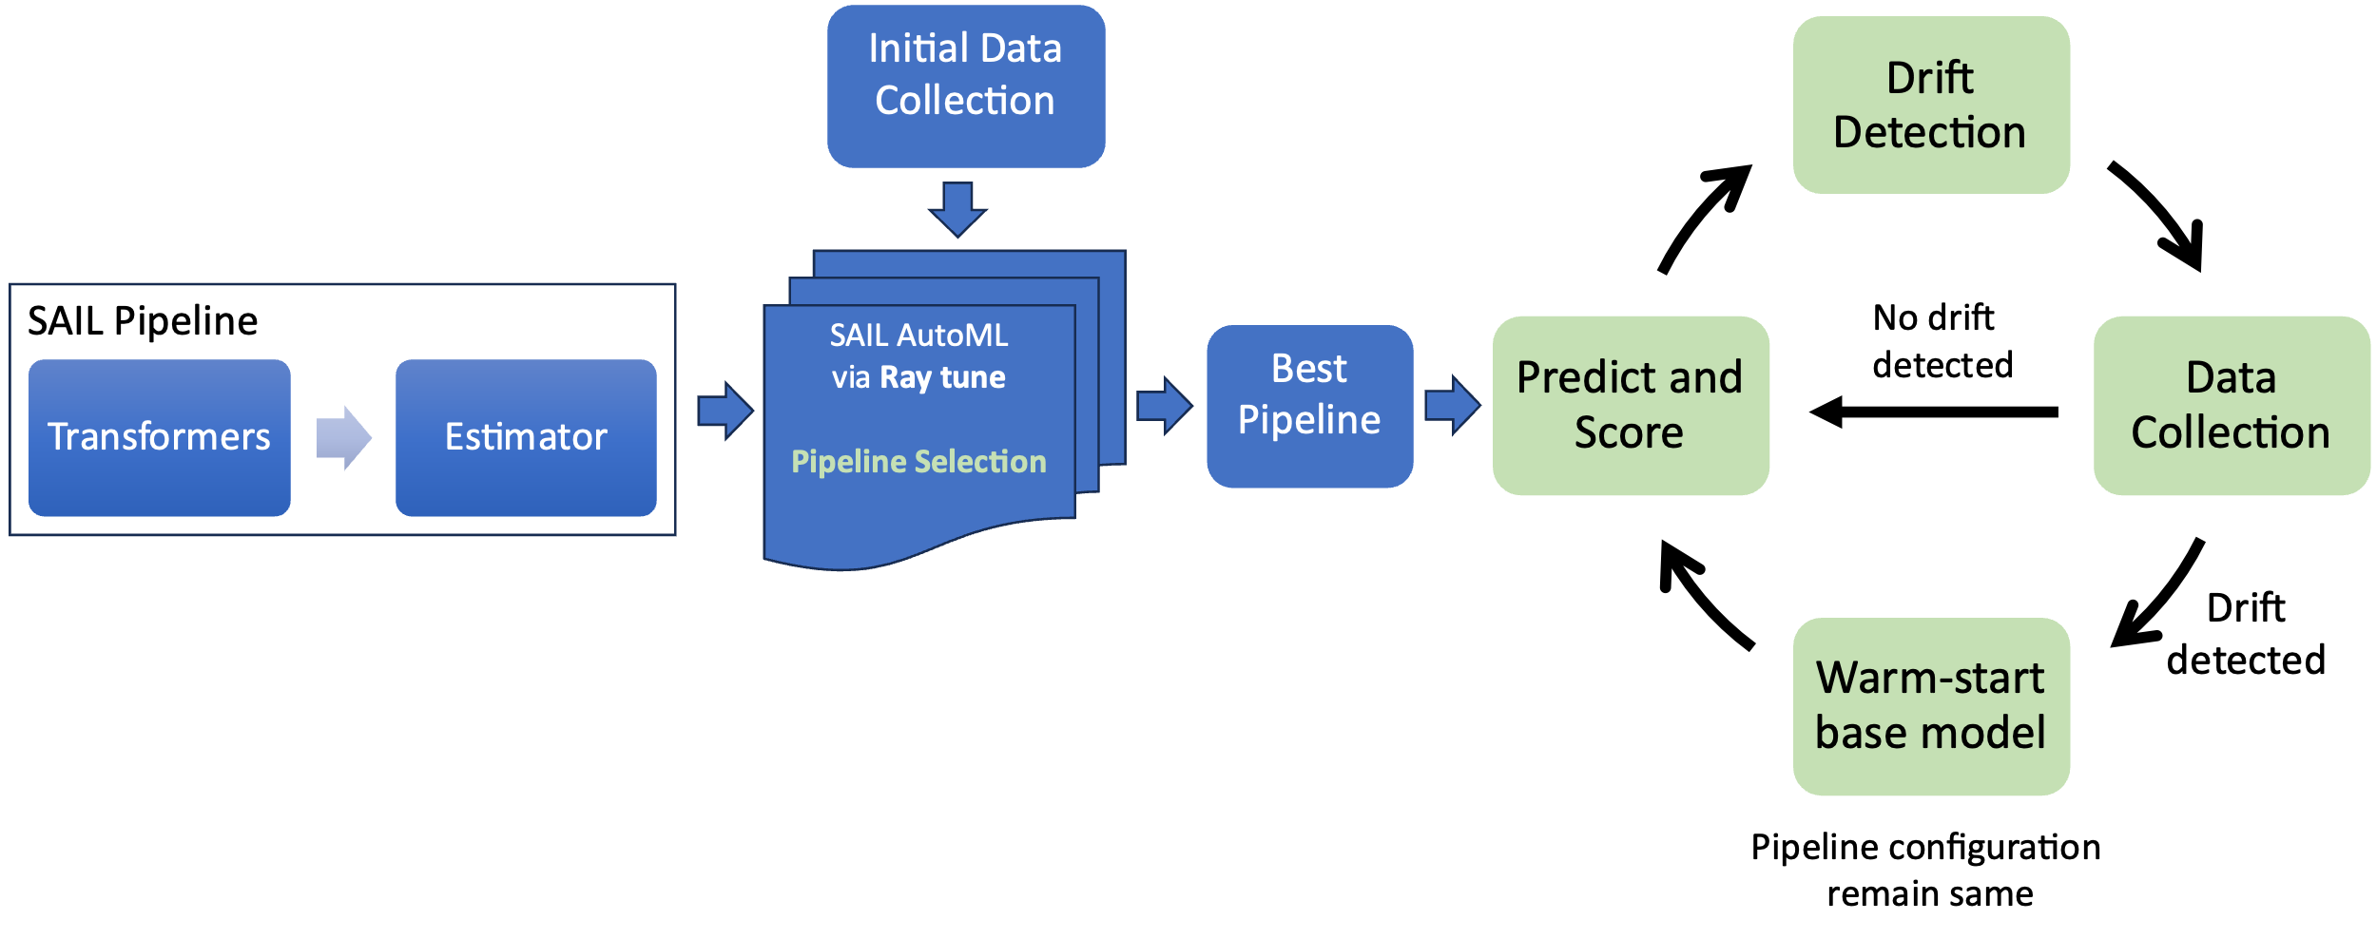
Observes changes in pipeline performance and uses this to detect concept drift.
This strategy assumes that the initial pipeline configuration will remain useful and only the base model need to be updated in case their performance dwindles because of concept drift.
It tests whether keeping a learner memory of past data is beneficial. This can give a performance boost if the learner can also adapt to the new data.
DetectAndIncrement
Celik, B., & Vanschoren, J. (2021). Adaptation strategies for automated machine learning on evolving data. IEEE transactions on pattern analysis and machine intelligence, 43(9), 3067-3078.

Slide 32
Observes changes in pipeline performance and uses this to detect concept drift.
This strategy also assumes that the initial pipeline configuration will remain useful. It Re- trains the base model from scratch on the latest data batches when the drift is detected.
It eliminates the need for rerunning the (expensive) AutoML process with every drift but may be less useful if the drift is so large that a pipeline redesign is needed.
DetectAndRetrain
Celik, B., & Vanschoren, J. (2021). Adaptation strategies for automated machine learning on evolving data. IEEE transactions on pattern analysis and machine intelligence, 43(9), 3067-3078.

Slide 33
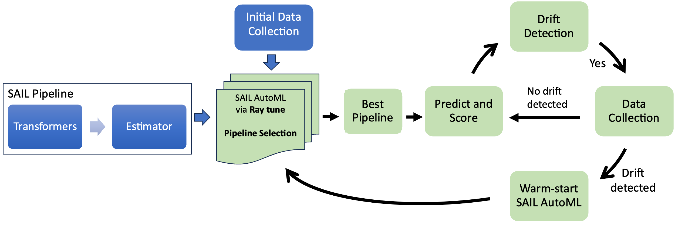
Observes changes in pipeline performance and uses this to detect concept drift.
After drift is detected, the AutoML technique is re-run with a ’warm start’ to find a better pipeline configuration.
This strategy assumes that the initial pipeline configurations are no longer optimal after concept drift and should be re-tuned.
Using a AutoML warm-start can lead to faster convergence to good configurations, hence working better under small time budgets.
DetectAndWarmStart
Celik, B., & Vanschoren, J. (2021). Adaptation strategies for automated machine learning on evolving data. IEEE transactions on pattern analysis and machine intelligence, 43(9), 3067-3078.

Slide 34
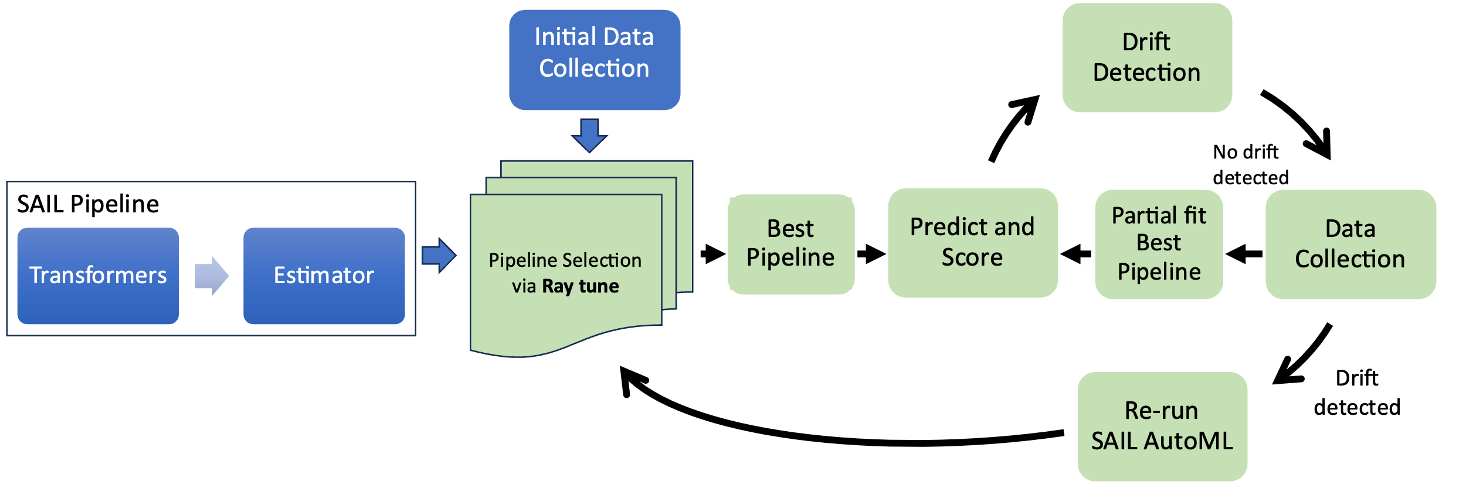
Observes changes in pipeline performance and uses this to detect concept drift.
After drift is detected, the AutoML technique is re-run from scratch, with a fixed time budget, to find a better pipeline configuration.
This strategy assumes that the initial pipeline configurations are no longer optimal after concept drift and should be re-trained.
Re-running the AutoML from scratch is more expensive but could result in significant performance improvements in case of significant drift.
DetectAndRestart
Celik, B., & Vanschoren, J. (2021). Adaptation strategies for automated machine learning on evolving data. IEEE transactions on pattern analysis and machine intelligence, 43(9), 3067-3078.

Slide 35
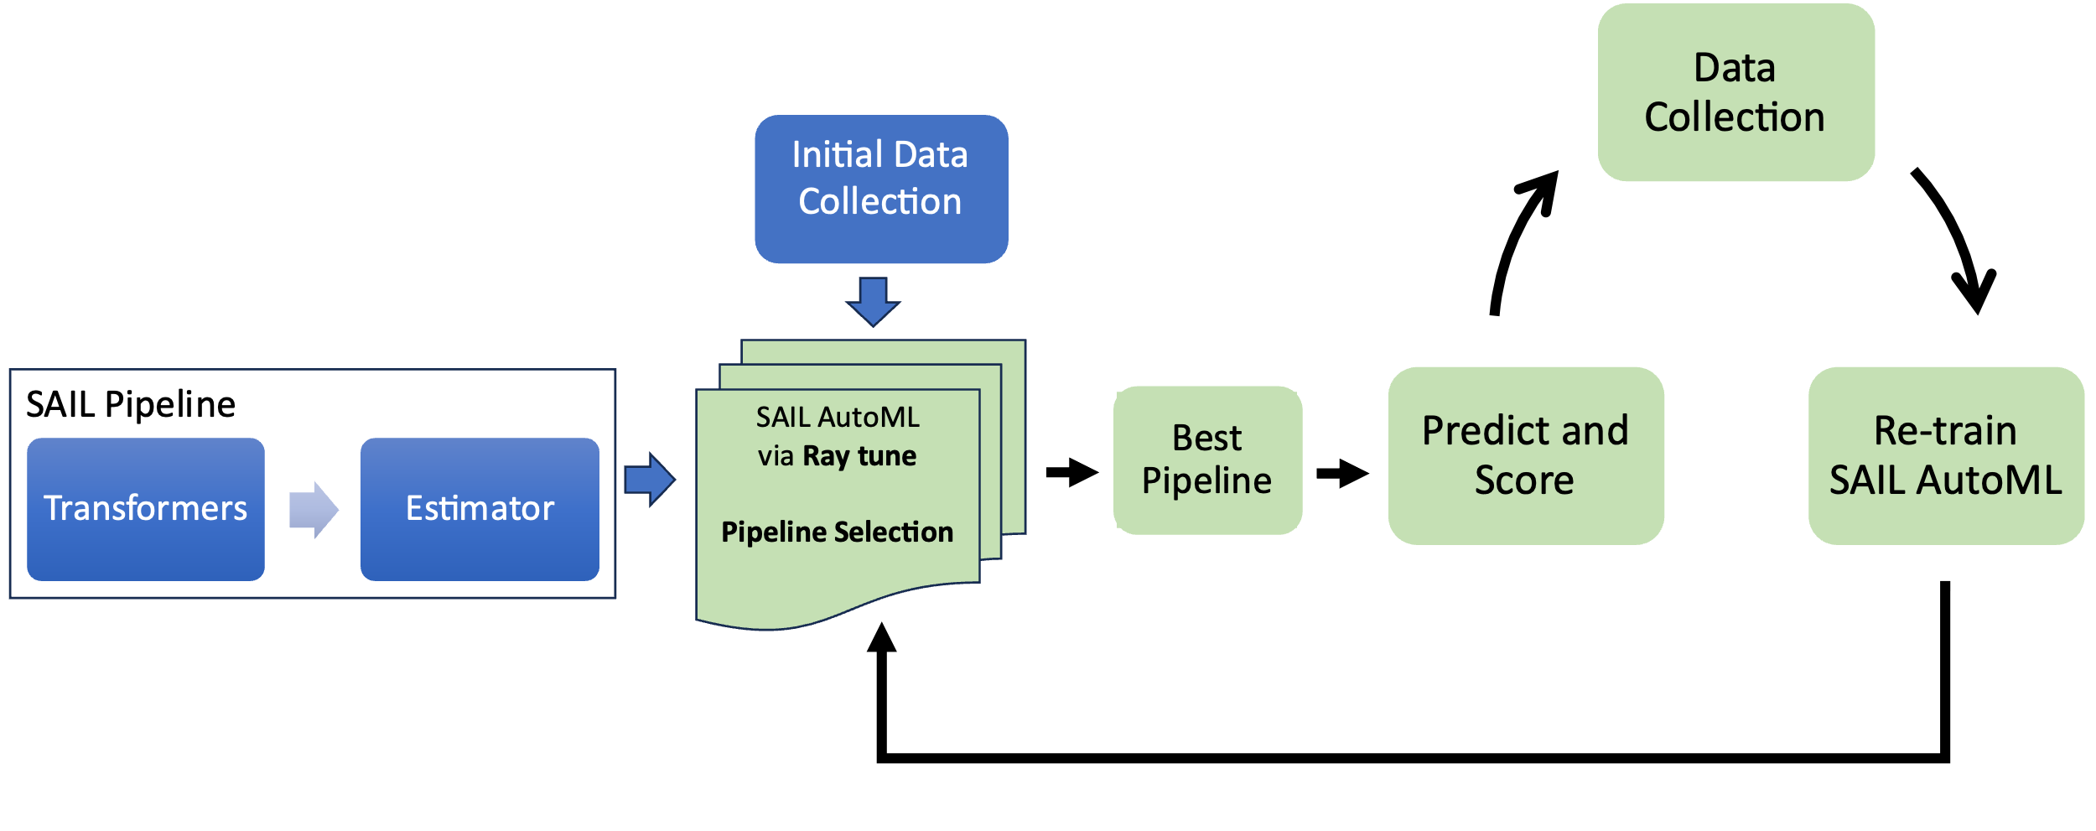
Instead of using a drift detector, AutoML is restarted with each new batch, or some other regular interval.
This strategy tests whether a drift detector is useful, and whether it is worth to retrain at certain intervals in spite of the significant computational cost.
PeriodicRestart
Celik, B., & Vanschoren, J. (2021). Adaptation strategies for automated machine learning on evolving data. IEEE transactions on pattern analysis and machine intelligence, 43(9), 3067-3078.

Slide 36
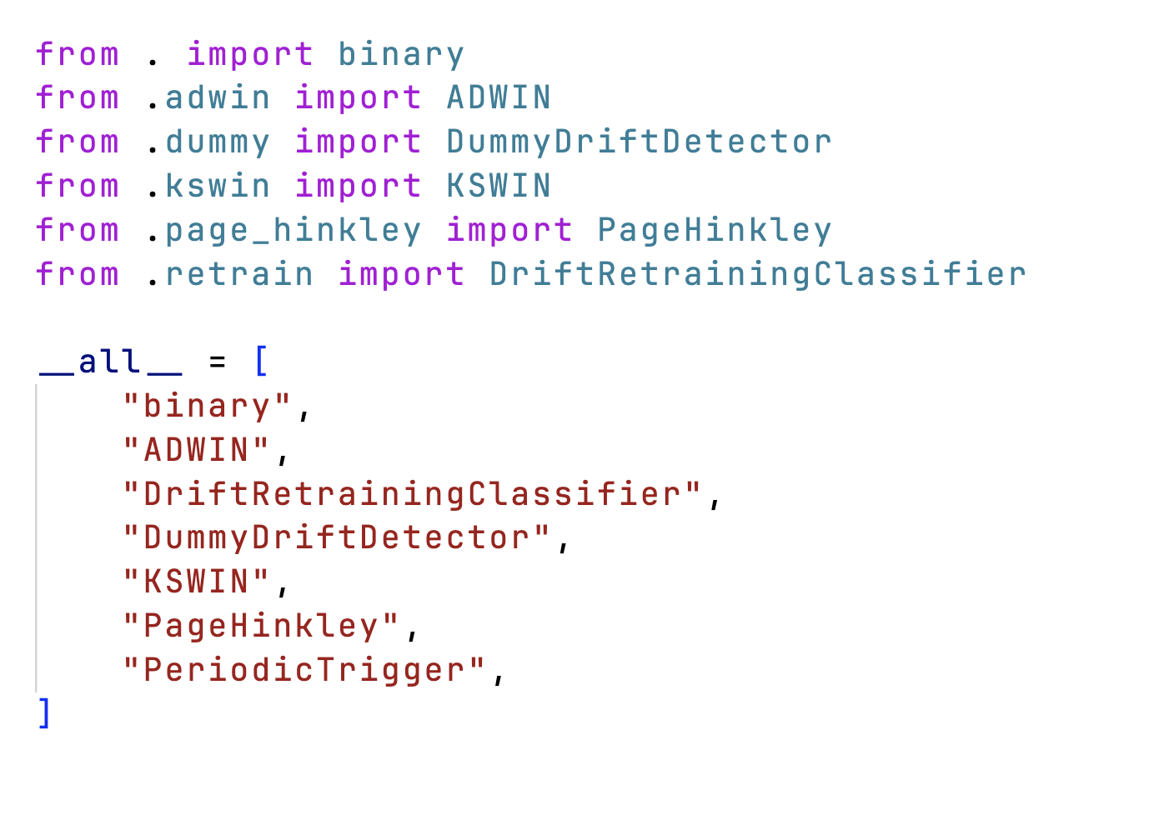
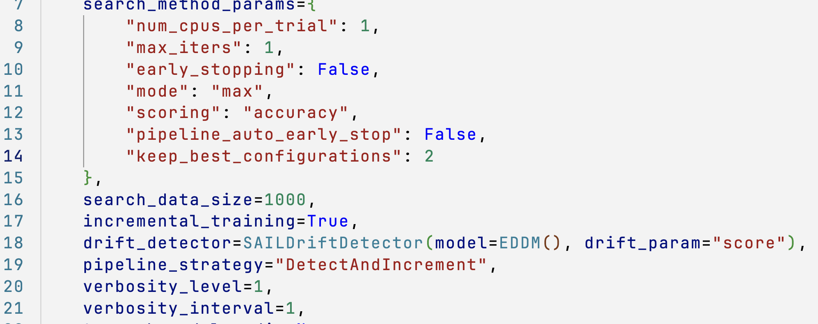
Step 10
Choose the Drift Detection algorithm and its parameters.
Example examples/models/auto_ml/sail_auto_pipeline_classification.ipynb

Slide 37
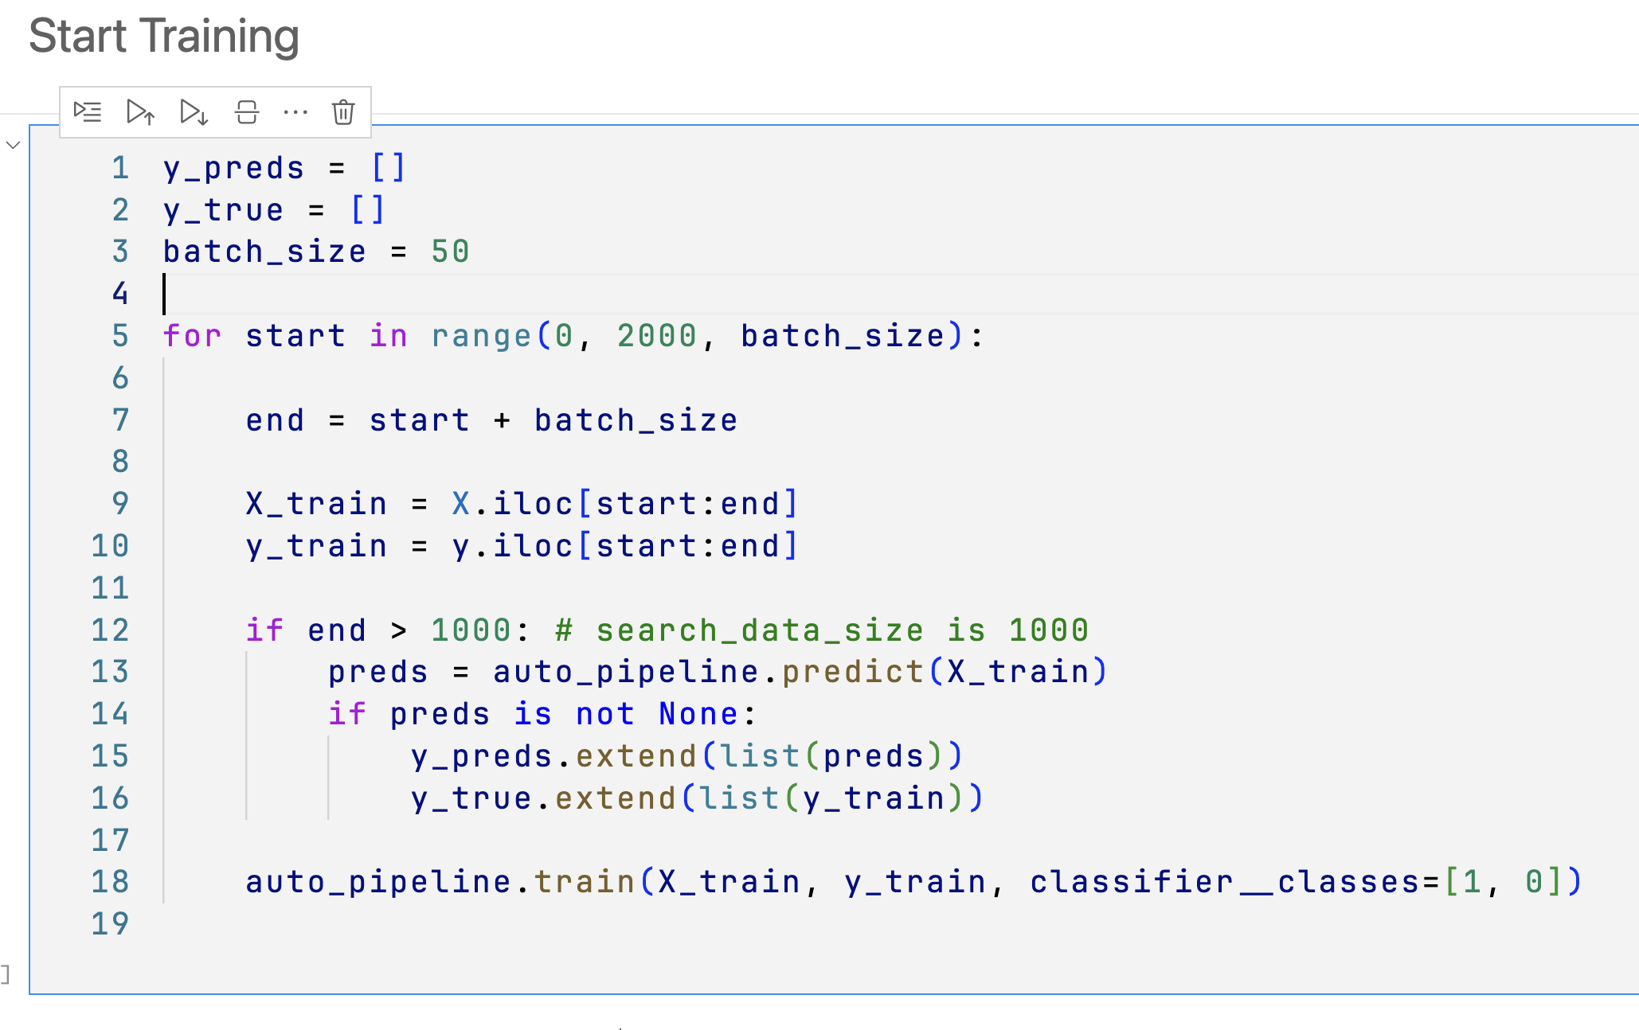
Step 11
Train SAIL Auto Pipeline on the dataset.
Example examples/models/auto_ml/sail_auto_pipeline_classification.ipynb

Slide 38
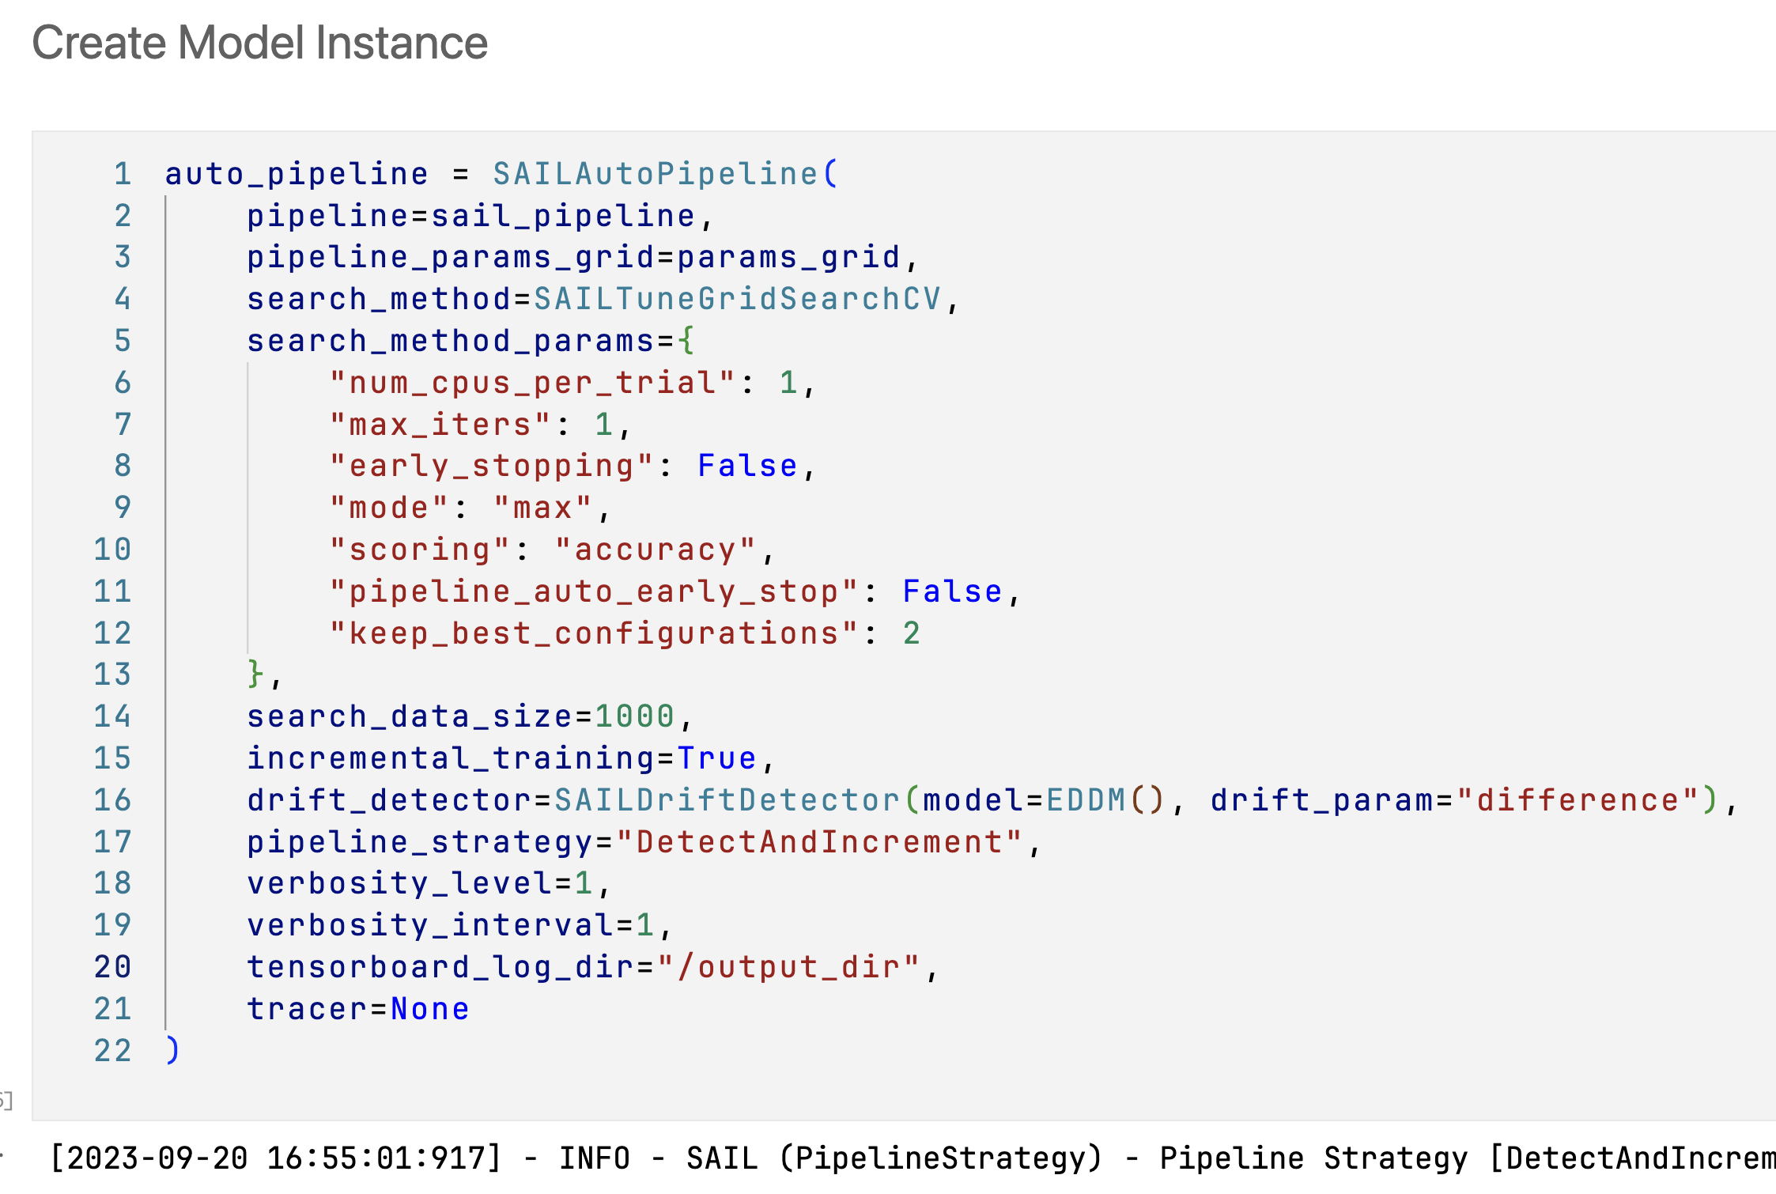
Step 12
Present Pipeline output and Drift Detection report via Tensorboard.
Example examples/models/auto_ml/sail_auto_pipeline_classification.ipynb

Slide 39
Contribute to SAIL https://github.com/IBM/sail/wiki/How-to-contribute-to-SAIL

Slide 40
Thank you Dr. Seshu Tirupathi seshutir@ie.ibm.com Dhaval Salwala dhaval.vinodbhai.salwala@ibm.com

